Slide 1

SECD2523 DATABASE
Structured Query Language (SQL) 2|
Data Manipulation Language (DML) 1
Content adapted from Connolly, T., Begg, C., 2015. Database Systems: A Practical Approach to Design, Implementation, and Management, Global Edition. Pearson Education.

Slide 2
LECTURE LEARNING OUTCOME
By the end of this lecture, students should be able to:
01
Write DML statements to add data into table, update data, and delete data using the following commands:
INSERT INTO … VALUES …
INSERT INTO … SELECT …
UPDATE … SET … [WHERE] …
DELETE FROM … [WHERE] …
02
Write DML statement to display records in tables
SELECT … FROM …
SELECT … FROM … WHERE
SELECT … FROM … WHERE … BETWEEN … AND
SELECT … FROM … WHERE … IN
SELECT … FROM … WHERE … LIKE

Slide 3
01
INSERT INTO … VALUES
02
INSERT INTO … SELECT
03
UPDATE … SET … [WHERE]
04
DELETE … FROM [WHERE]
05
SELECT … FROM … [WHERE]
06
SELECT … FROM … WHERE … [BETWEEN … AND] / [IN] / [LIKE]
07
RULES OF PRECEDENCE

Slide 4
SQL Statements
STATEMENTS | TYPE
SELECT INSERT UPDATE DELETE MERGE | DATA MANIPULATION LANGUAGE (DML) Retrieves data from database, enters new rows, changes existing rows, and removes unwanted rows from tables in the database, respectively
CREATE ALTER DROP RENAME TRUNCATE COMMENT | DATA DEFINITION LANGUAGE (DDL) Sets up, changes, and removes data structures from tables
GRANT REVOKE | DATA CONTROL LANGUAGE (DCL) Provides or removes access rights to both the Database and the structures within it
COMMIT ROLLBACK SAVEPOINT | TRANSACTION CONTROL Manages the changes made by DML statements. Changes to the data can be grouped together into logical transactions

Slide 5
Writing SQL Statements
SQL statements are not case sensitive (unless indicated).
SQL statements can be entered on one or more lines.
Keywords cannot be abbreviated or split across lines
Clauses are usually placed on separate lines
Indents are used to enhance readability

Slide 6
Human Resource (HR) schema
In the HR records, each employee has an identification number, email address, job identification code, salary, and manager. Some employees earn commissions in addition to their salary
The company also tracks information about jobs within the organization. Each job has an identification code, job title, and a minimum and maximum salary range for the job. Some employees have been with the company for a long time and have held different positions within the company. When an employee resigns, the duration the employee was working for, the job identification number, and the department are recorded.

Slide 7
Human Resource (HR) schema
The sample company is regionally diverse, so it tracks the locations of its warehouses and departments. Each employee is assigned to a department, and each department is identified by a unique department number or short name. Each department is associated with one location, and each location has a full address that includes the street name, postal code, city, state or province, and the country code.
In places where the departments and warehouses are located, the company records details such as the country name, currency symbol, currency name, and the region where the country is located geographically.

Slide 8
INSERT INTO … VALUES
Purpose: To insert a row of data into a table.
Syntax:
Example: Insert a new row into table Department:
INSERT INTO tableName (column1, column2, column3)
VALUES (value1, value2, value3);
INSERT INTO departments
VALUES (70,’Public Relations’,100,70);
OR
INSERT INTO departments (department_id, department_name, manager_id, location_id)
VALUES (70,’Public Relations’,100,70);
NOTE: Use single quote (‘) for string / character data

Slide 9
Inserting rows with NULL values
Implicit method: Omit the column from the column list
Explicit method: Specify the NULL keyword in the VALUES clause
INSERT INTO departments (department_id, department_name)
VALUES (30, ‘Purchasing’);
INSERT INTO departments (department_id, department_name)
VALUES (30, ‘Purchasing’, NULL, NULL);
department_id | department_name | manager_id | location_id
30 | Purchasing

Slide 10
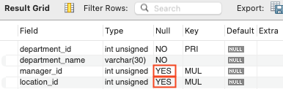
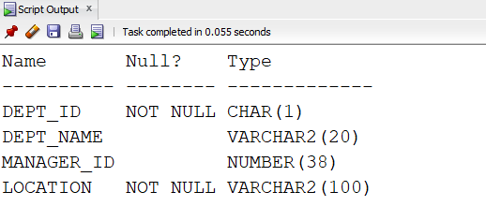
Attention: Inserting NULL values
Be sure that you can use the NULL value in the targeted column by verifying the NULL status with the DESCRIBE command
Output of DESCRIBE in MySQL
Output of DESCRIBE in Oracle

Slide 11
Attention: Inserting NULL values
Common errors that can occur during the user input are checked in the following order:
  Mandatory value missing for a NOT NULL column
  Duplicate value violating any unique or primary key constraint
  Any value violating a CHECK constraint
  Referential integrity maintained for a foreign key constraint
  Data type mismatch or values too wide to fit in column

Slide 12
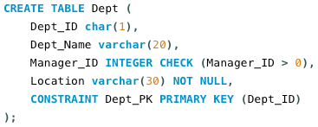
Attention: Inserting NULL values
Any value violating a CHECK constraint
  CHECK is a constraint that set a specific condition for the input data to follow. E.g.: DDL statement below:
  Example above: the column “Manager_ID” has a CHECK constraint that checks if the input is larger than zero,
  Therefore, only input that is larger than zero is allowed to enter the column. Error example in mySQL:
Error Code: 3819. Check constraint 'dept_chk_1' is violated.

Slide 13
Attention: Inserting NULL values
Referential integrity maintained for a foreign key constraint
  Whenever the foreign key exists in the table, according to Referential Integrity constraint, the value can either be:
    Values exist in the parent table foreign key refers to. OR
    Wholly NULL
  Therefore, non-NULL values that does not exist at the table where the foreign key refers to are not allowed to enter in the column. Error example in Oracle:
Error Code: 1452. Cannot add or update a child row: a foreign key constraint fails (`hr`.`employees`, CONSTRAINT `employees_ibfk_1` FOREIGN KEY (`job_id`) REFERENCES `jobs` (`job_id`))

Slide 14
Recommendation: Inserting NULL values
Use of the column list is recommended because it makes the INSERT statement more readable and reliable, or less prone to mistakes. Example
INSERT INTO tableName (column1, column2, column3)
VALUES (value1, value2, value3);

Slide 15
Inserting Special Values
The SYSDATE()function records the current date and time
INSERT INTO employees
(employee_id, first_name, last_name, email, hire_date, job_id, salary)
VALUES
(300, ‘Mikail’, ‘Hafiz’, ‘MHAFIZ’, SYSDATE(), ‘IT_PROG’, 9000);

Slide 16
Inserting specific Date and Time
The DD-MON-RR format is generally used to insert a date value.
You may also supply the date value in DD-MON-YYYY format.
This is recommended because it clearly specifies the century and does not depend on the internal RR format logic specifying the correct century
INSERT INTO employees
(employee_id, first_name, last_name, email,hire_date, job_id, salary)
VALUES
(400, ‘Yusuf’, ‘Syarin’, ‘YSYARIN’, ‘2024-12-12’, ‘SA_REP’, 8000);
For MySQL, use “YYYY-MM-DD” format for DATE datatype

Slide 17
INSERT INTO … SELECT
To insert data from an existing table
Write the INSERT statement with a subquery
DO NOT use the VALUES clause
Match the number of columns in the INSERT clause to those in the subquery
INSERT INTO sales_reps (id, name, salary, commission_pct)
SELECT employee_id, last_name, salary, commission_pct
FROM employees
WHERE job_id LIKE ‘%REP%’;

Slide 18
UPDATE … SET
Purpose: To modify existing values in a table.
Syntax:
Example: Update the department ID of employee with the ID of 113 to 50
[ ] = OPTIONAL
UPDATE table-name
SET col1 = update-value[,col2 = update-value]
[WHERE search-condition]
UPDATE employees
SET department_id = 50
WHERE employee_id = 113;

Slide 19
Update Two Columns with a Subquery
Can also be done for multiple subqueries
[ ] = OPTIONAL
UPDATE table
SET column = (SELECT column
FROM table
WHERE condition)
[,column2 = (SELECT column
FROM table
WHERE condition)]
[WHERE condition]

Slide 20
Update Two Columns with Subquery
Example: Update employee 113’s job and salary to match those of employee 205
UPDATE employees
SET (job_id, salary) =
(SELECT job_id, salary
FROM employees
WHERE employee_id = 205)
WHERE employee_id = 113;

Slide 21
DELETE FROM
Purpose: To delete existing rows from table
Syntax:
Example: Delete the record of department Finance
All rows in the table are deleted if you omit the WHERE clause.
[ ] = OPTIONAL
DELETE FROM table-name
[WHERE search-condition]
DELETE FROM departments
WHERE department_name = ‘Finance’;
DELETE FROM departments

Slide 22
SELECT … FROM
To retrieve and display data from one or more tables.
[ ] = OPTIONAL
SELECT col1, col2, … coln
FROM TableName [,TableName]
[WHERE condition]
[GROUP BY columnList]
[HAVING condition]
[ORDER BY columnList]

Slide 23
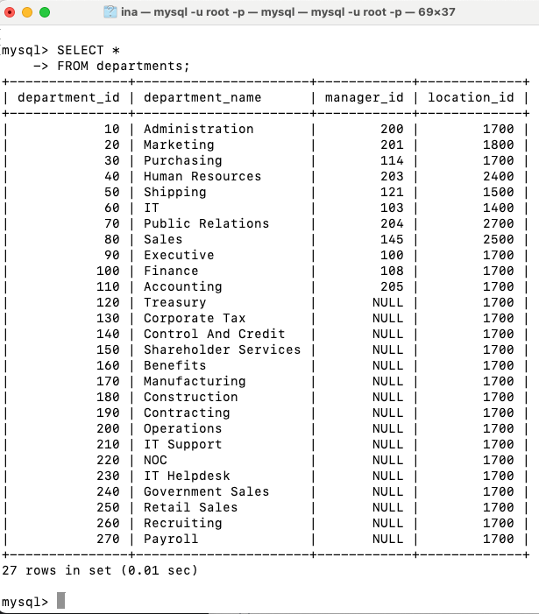
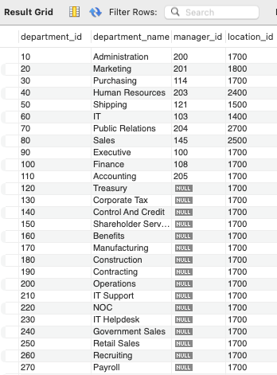
SELECT … FROM
Retrieve all columns and all rows
List the full details of the DEPARTMENTS table
SELECT *
FROM departments;

Slide 24
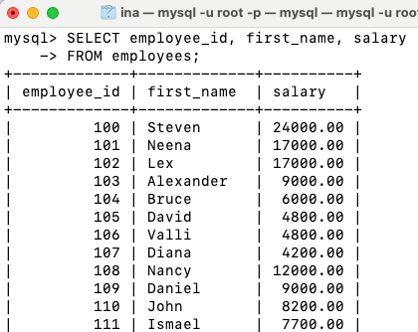
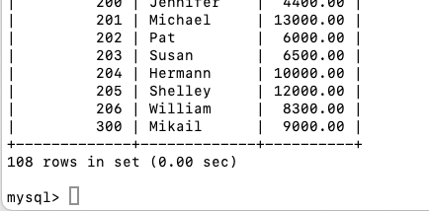
SELECT … FROM
Retrieve specific columns, all rows
Example:
Produce a list of salaries for all staff, displaying only the employee ID, first name and salary
SELECT employee_id, first_name, salary
FROM employees;
…

Slide 25
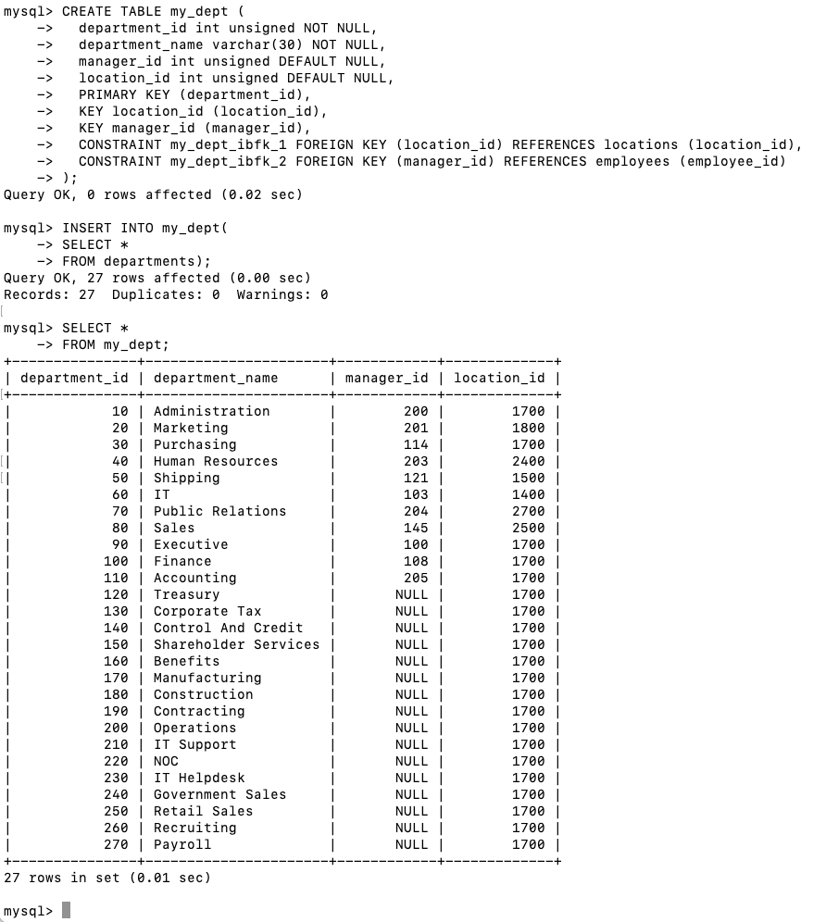
INSERT INTO … SELECT
Copy multiple row of records into a different table
Example
  Get the command for creating existing table departments
  Create a new table name my_dept with the same structure as table departments
  Copy all records from departments table to my_dept
Constraint name must be unique
SHOW CREATE TABLE departments;
INSERT INTO my_dept (
SELECT *
FROM departments);
Notes:
Create a new table name my_dept with the same structure as table departments (when copying the command from above, ensure to rename constraint names as they are unique in a schema/database)

Slide 26
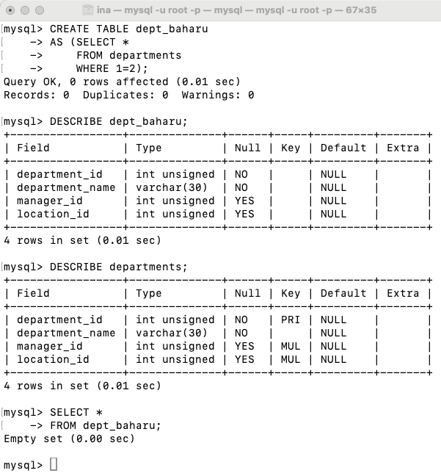
Create new table by copying the structure of an existing table
Create a new table name dept_baharu with the same structure as table departments.
This would create a new table called dept_baharu that includes all columns from the departments table WITHOUT the data from departments
CREATE TABLE dept_baharu
AS (SELECT *
FROM departments
WHERE 1=2);

Slide 27
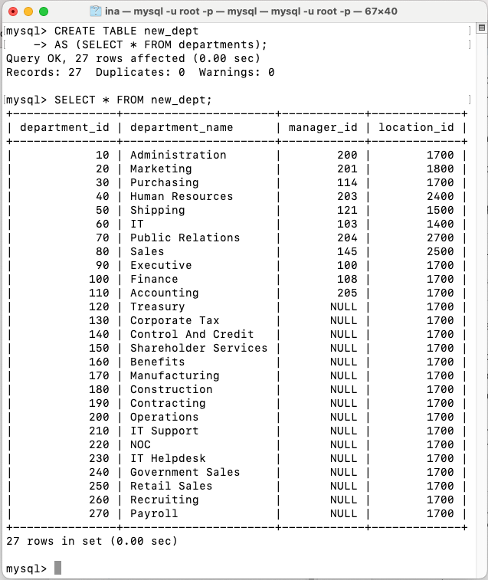
Create new table by copying the structure of an existing table (and data)
Create a new table name new_dept with the same structure as table departments.
This would create a new table called new_dept that includes all columns from the departments table INCLUDING all the data from departments
CREATE TABLE new_dept
AS (SELECT * FROM departments);

Slide 28
SELECT…FROM…WHERE (1)
To list only selected row of records based on conditions
Conditions involve comparison operators and/or logical operators
  Comparison operators:
    = <> < > <= >= !=
    BETWEEN..AND LIKE IN(set)
  Logical operators:
    AND OR NOT
SELECT list-of-columns
FROM list of tables
WHERE search-condition;

Slide 29
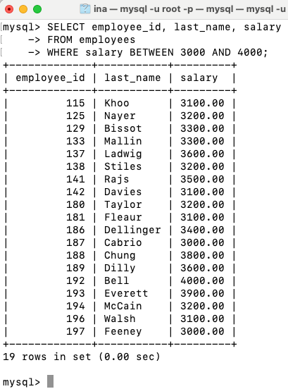
SELECT…FROM…WHERE…BETWEEN…AND
Example:
  List all employee ID, last_name, salary where salary is between 3000 and 4000
SELECT employee_id, last_name, salary
FROM employees
WHERE salary BETWEEN 3000 AND 4000;

Slide 30
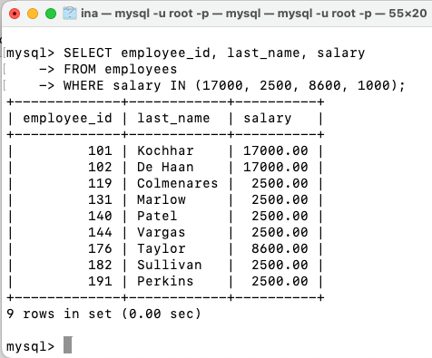
SELECT…FROM…WHERE…IN
To search values in a list set
Example:
  List all employees whose salaries are 17000, 2500, 8600, 1000
SELECT employee_id, last_name, salary
FROM employees
WHERE salary IN (17000, 2500, 8600, 1000);
There is no employee with a salary of 1000.
Therefore, it does not return a value.

Slide 31
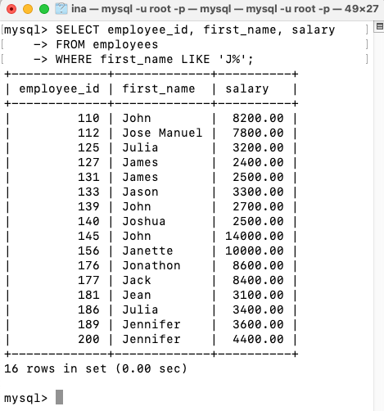
SELECT…FROM…WHERE…LIKE (1)
To perform wild card searchers of valid search string values
  _ (underscore symbol) denotes one character
  % denotes zero or many character
Example:
  List all employee whose first name starts with a J
SELECT employee_id, first_name, salary
FROM employees
WHERE first_name LIKE ‘J%’;

Slide 32
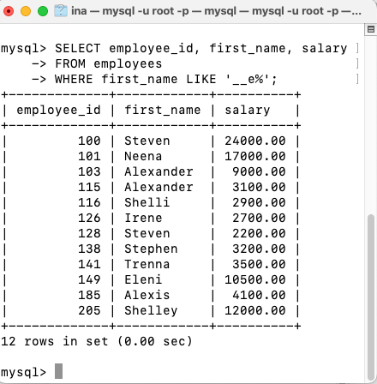
SELECT…FROM…WHERE…LIKE (2)
Example:
List all employees whose first name’s third letter is an E
SELECT employee_id, first_name, salary
FROM employees
WHERE first_name LIKE ‘__e%’;
(2 underscore symbols)

Slide 33
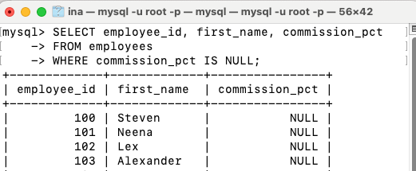
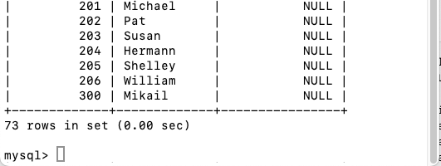
SELECT…FROM…WHERE…IS NULL
To search for columns with null value
Example:
  List all employees who has not receive any commission.
…
SELECT employee_id, first_name, commission_pct
FROM employees
WHERE commission_pct IS NULL;

Slide 34
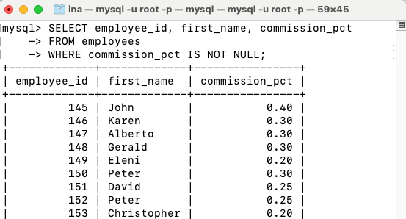
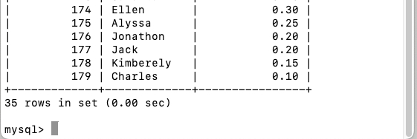
SELECT…FROM…WHERE…IS NOT NULL
To search for columns with value is not NULL
Example:
  List all employees who have received any commissions
SELECT employee_id, first_name, commission_pct
FROM employees
WHERE commission_pct IS NOT NULL;
…

Slide 35
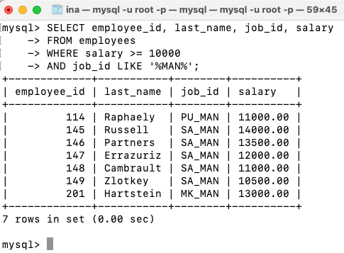
SELECT…FROM…WHERE…AND
AND requires both component conditions to be true
SELECT employee_id, last_name, job_id, salary
FROM employees
WHERE salary >= 10000
AND job_id LIKE ‘%MAN%’;
CONDITION 1
CONDITION 2

Slide 36
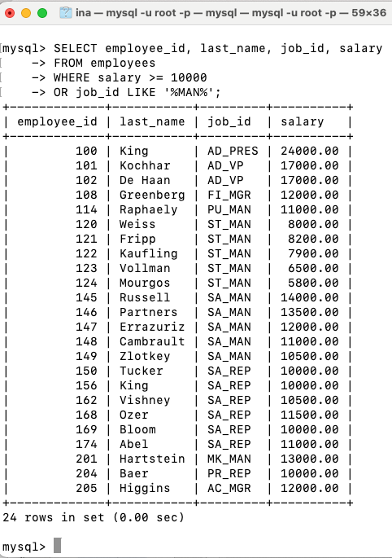
SELECT…FROM…WHERE…OR
OR requires either component conditions to be true
SELECT employee_id, last_name, job_id, salary
FROM employees
WHERE salary >= 10000
OR job_id LIKE ‘%MAN%’;
CONDITION 1
CONDITION 2

Slide 37
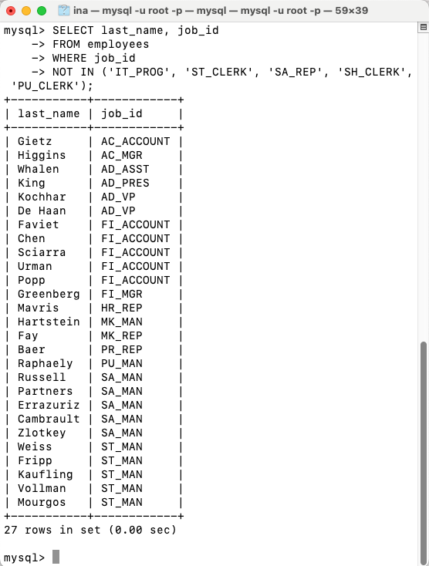
NOT operator
Example:
  Display the last name and job ID of employees whose job ID is not IT_PROG, ST_CLERK, SA_REP, SH_CLERK, or PU_CLERK
SELECT last_name, job_id
FROM employees
WHERE job_id
NOT IN (‘IT_PROG’, ‘ST_CLERK’, ‘SA_REP’, ‘SH_CLERK’, ‘PU_CLERK’);

Slide 38
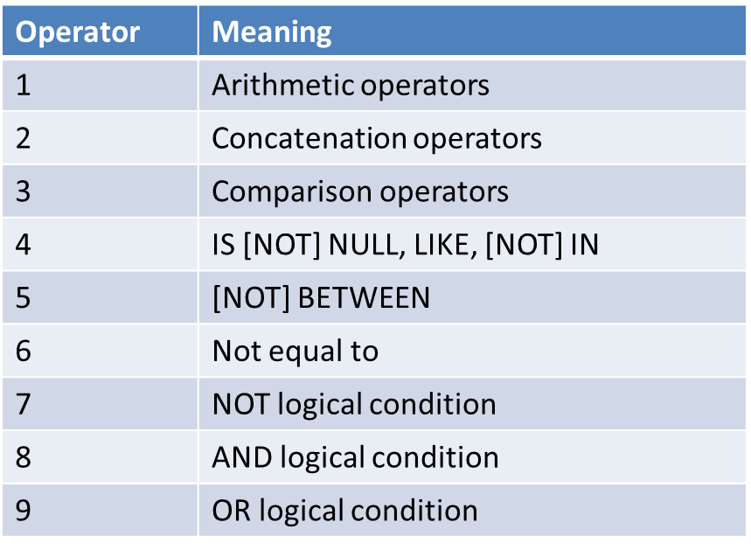
Rules of precedence
You can use parenthesis to override rules of precedence

Slide 39
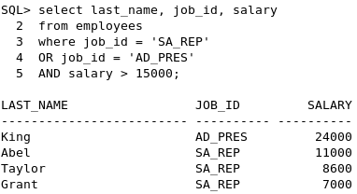
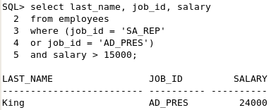
Rules of Precedence
SELECT last_name, job_id,salary
FROM employees
WHERE job_id = ‘SA_REP’
OR job_id = ‘AD_PRES’
AND salary > 15000;
1
Check this condition first
SELECT last_name, job_id,salary
FROM employees
WHERE (job_id = ‘SA_REP’
OR job_id = ‘AD_PRES’)
AND salary > 15000;
2
Check the one with parenthesis first

Slide 40
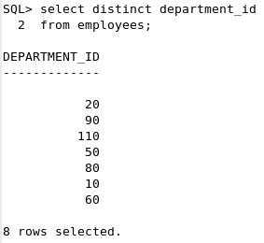
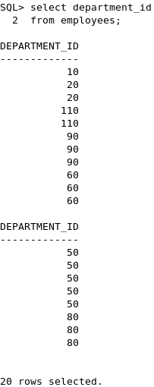
DISTINCT (1)
The default display of queries is all rows, including duplicate rows
Use the DISTINCT keyword immediately after the SELECT keyword to eliminate duplicate rows
SELECT DISTINCT department_id
FROM employees;

Slide 41
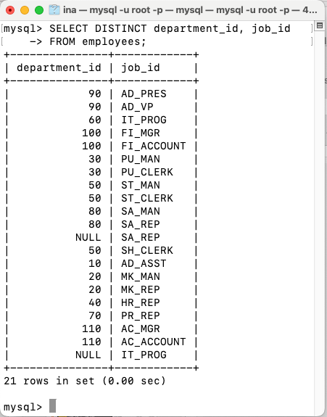
DISTINCT (2)
Multiply columns can be specified after the DISTINCT qualifier
This affects all the selected columns, and the result is every distinct combination of the columns
SELECT DISTINCT department_id, job_id
FROM employees;

Slide 42
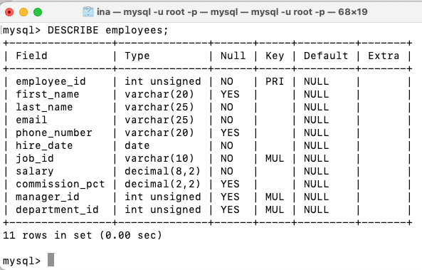
DESCRIBE
Use the DESCRIBE command to display the structure of a table

Slide 43
SUMMARY
INSERT INTO : To add new values (data) into a table
UPDATE … SET : To update existing value of a column with a new value
SELECT … FROM : To retrieve records in table(s)
SELECT … FROM …. WHERE : To retrieve record that match certain condition

Slide 44
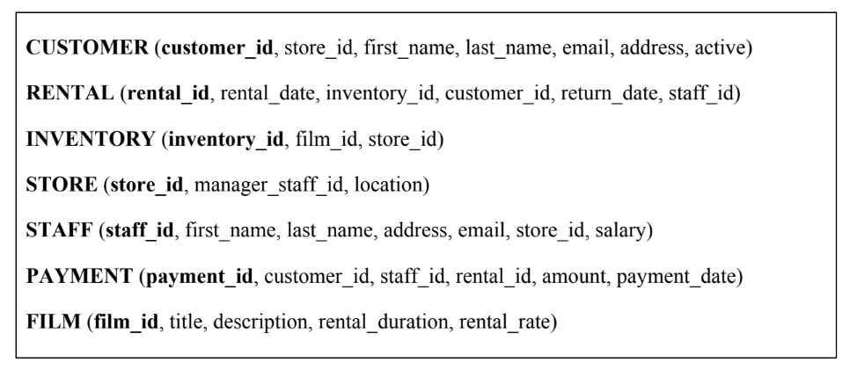
Simple Handwritten Exercise
Given the following relation schemas, construct the SQL statement for following tasks:
List all films title, rental duration and rental rate.
List all customers’ details who registered to store with ID of ST_002.
Insert a new film in database which has the film ID ‘F_0099’, title ‘My Neighbour Totoro’, description ‘Is a 1998 Japanese animated film by Hayao Miyazaki’, rental duration 14 days, and rental rate of RM8.

Slide 45
Simple Handwritten Exercise (Answer)
List all films title, rental duration and rental rate.
List all customers’ details who registered to store with ID of ST_002.
Insert a new film in database which has the film ID ‘F_0099’, title ‘My Neighbour Totoro’, description ‘Is a 1998 Japanese animated film by Hayao Miyazaki’, rental duration 14 days, and rental rate of RM8.
SELECT title, rental_duration, rental_rate FROM FILM;
SELECT * FROM CUSTOMER WHERE store_id=‘ST_002’;
INSERT INTO FILM (film_id, title, description, rental_duration, rental_rate)
VALUES (‘F_0099’, ‘My Neighbour Totoro’, ‘Is a 1998 Japanese animated film by Hayao Miyazaki’, 14, 8)

Slide 46


